Slide 1
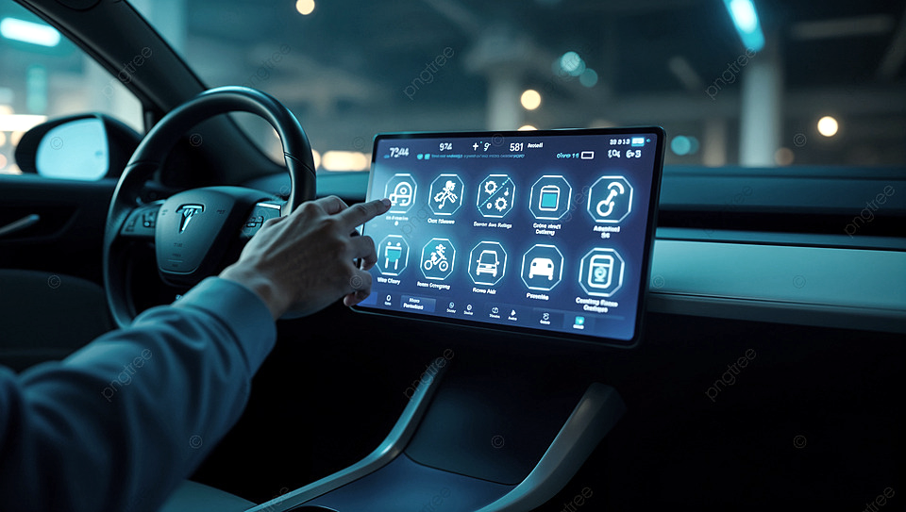

Smart Car Dashboard
Real-time vehicle insights with Embedded connectivity powered by CAN & Cloud sync

Slide 2
Team Members :
Akash Dubey (250840130005)
Allu Sai Aravind (250840130008)
Bhavesh Satkar (250840130010)
Shivam Nadarge (250840130027)
Gowtham Sambaladeevi (250840130042)
Guided by
Mr. Shreepad Deshpande

Slide 3
Objective :
Project Aim :
To design a real-time Smart Car Dashboard enabling deterministic vehicle monitoring, robust CAN bus communication and IoT cloud integration for enhanced driver safety and remote diagnostics.
Objectives :
Real-Time Data Acquisition:
Implement STM32F407 with FreeRTOS to monitor speed, battery and safety status.
In-Vehicle Communication:
Establish a reliable CAN bus network for data transmission between STM32 & ESP32.
IoT Gateway Implementation:
Configure ESP32 to bridge vehicle data to cloud platforms and data logging.
Cloud Connectivity:
Integrate AWS IoT via MQTT for scalable remote monitoring and data logging.
HMI Design:
Develop an intuitive driver interface using DWIN LCD for real-time visualization.

Slide 4
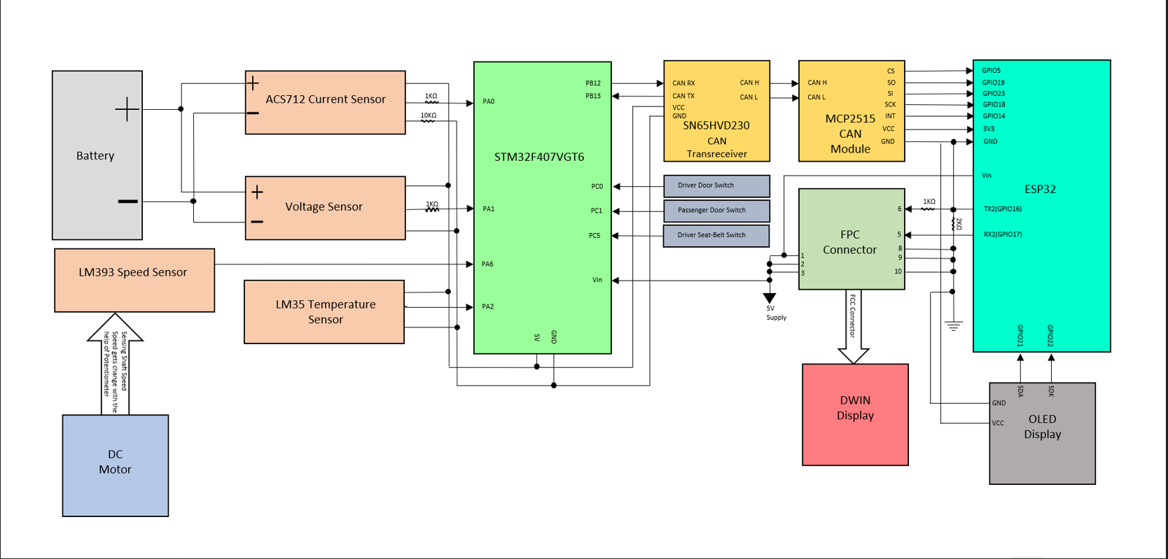
Hardware Architecture:

Slide 5
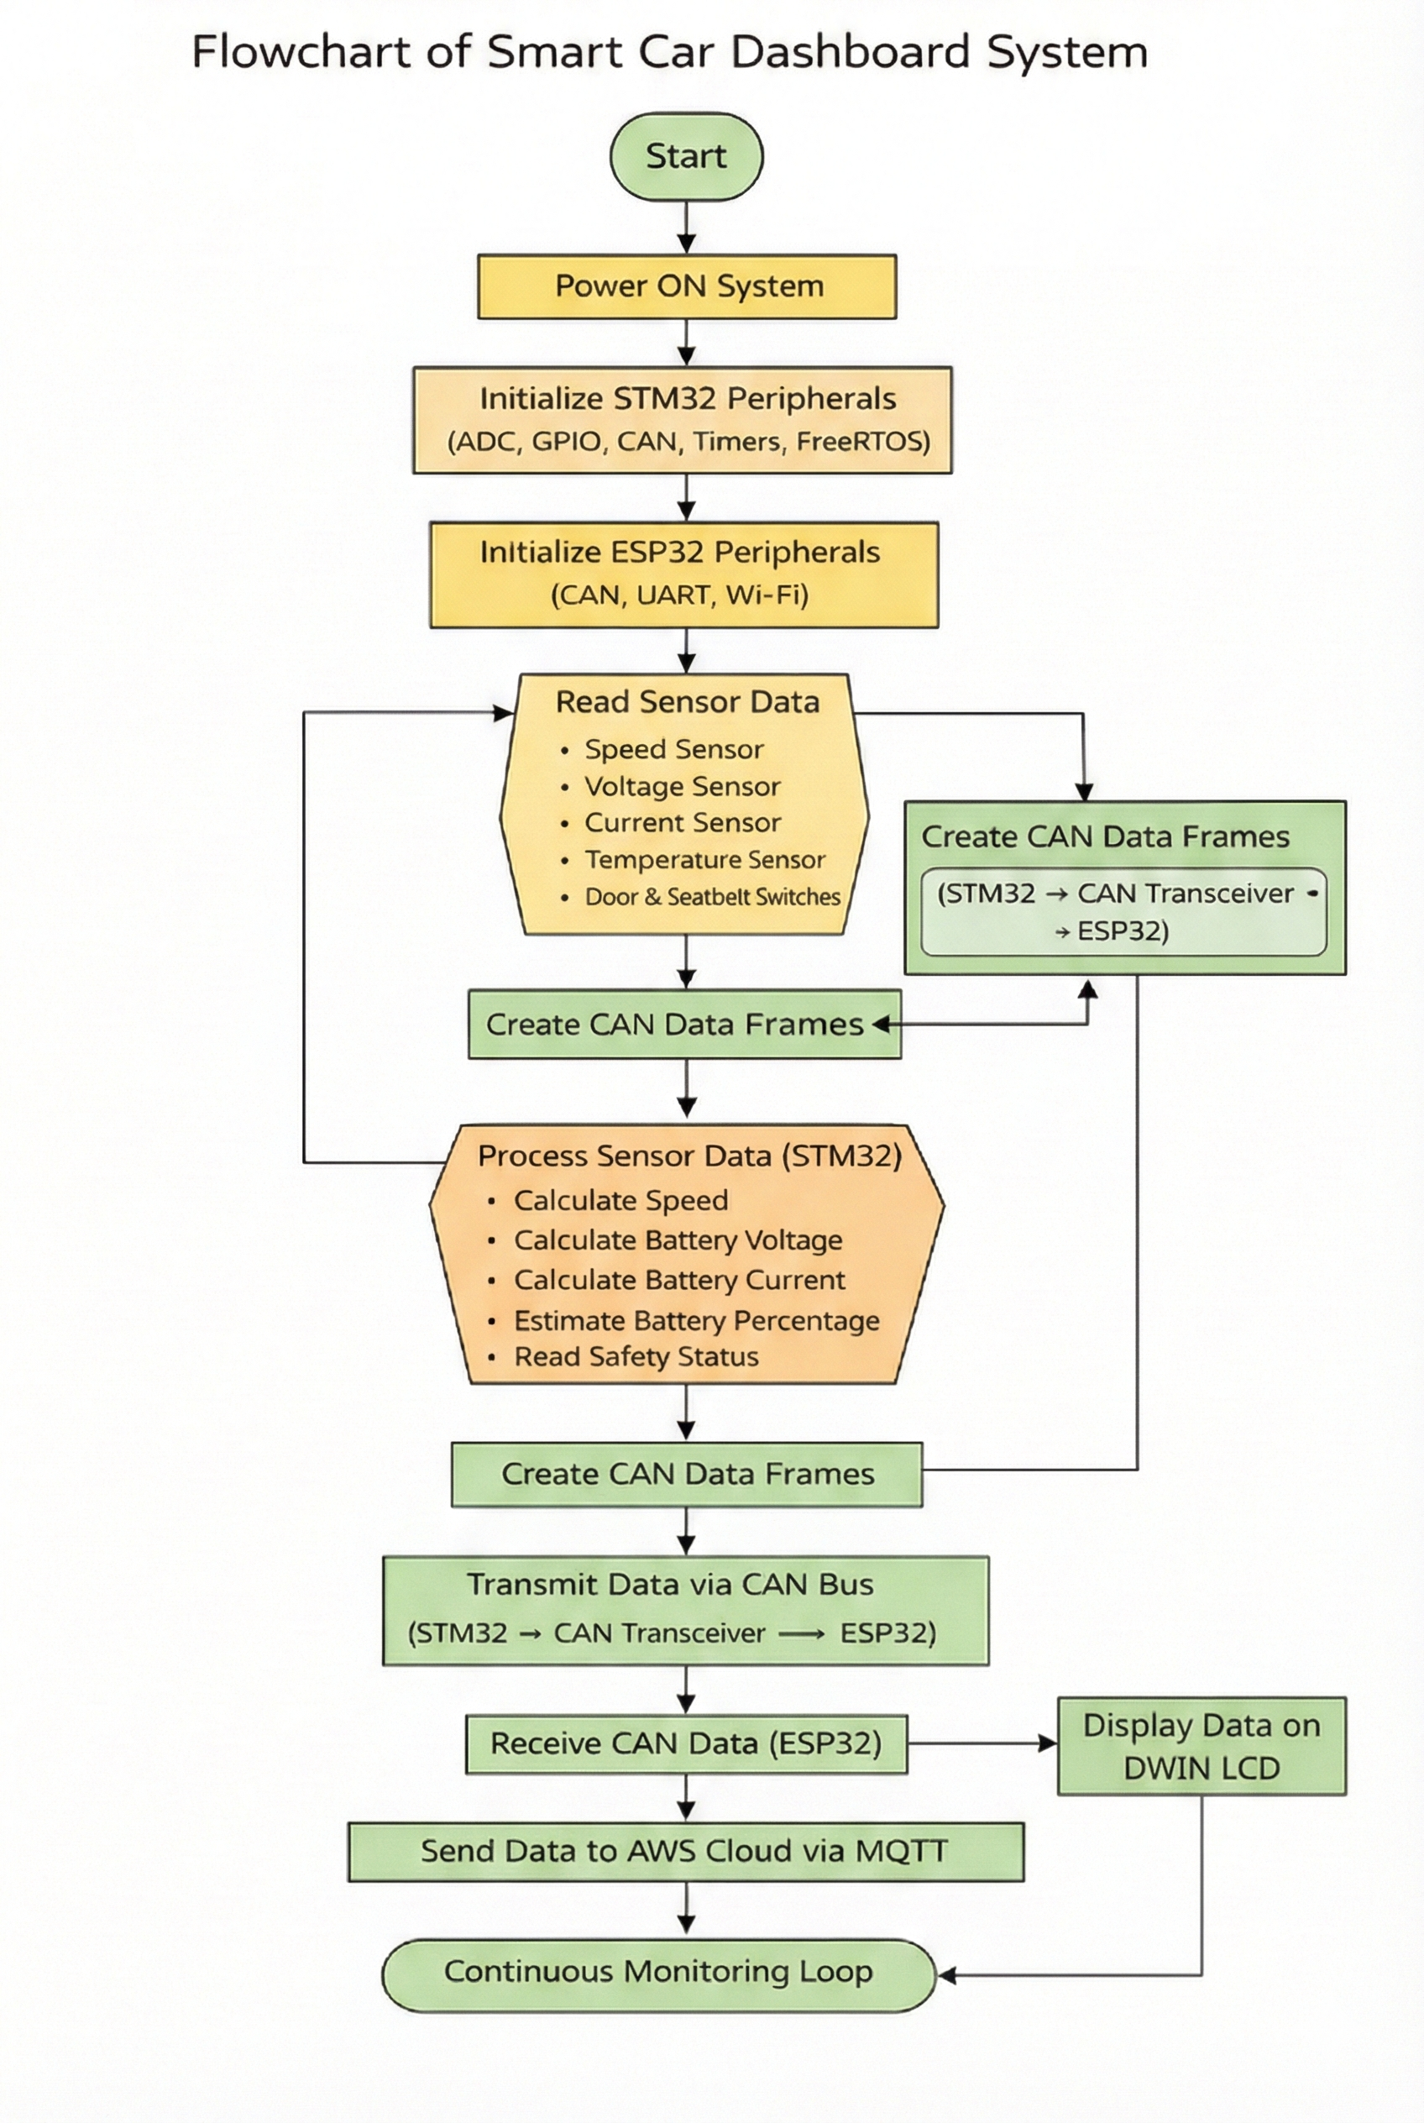
Workflow

Slide 6
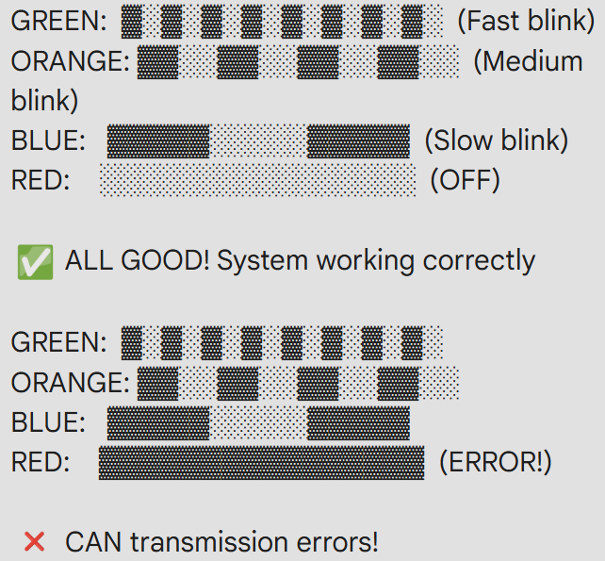
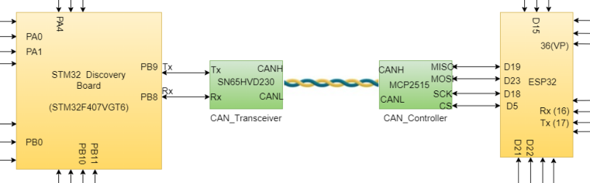
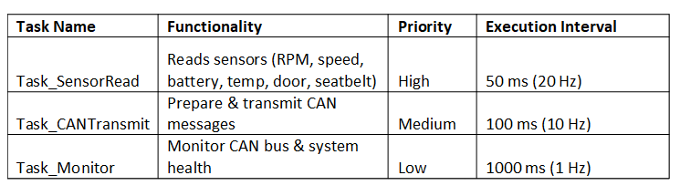
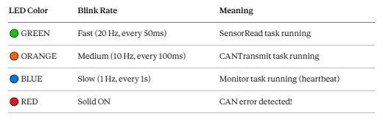
Communication & Task Architecture

Slide 7
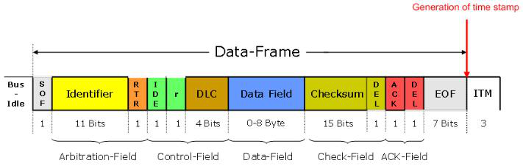
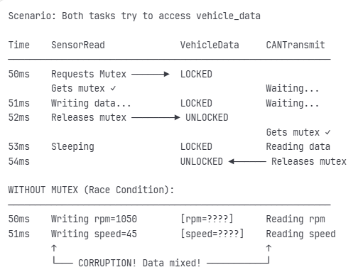
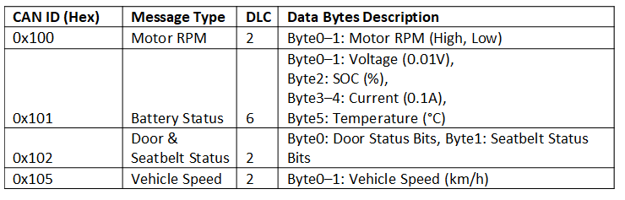
Communication & Task Architecture

Slide 8
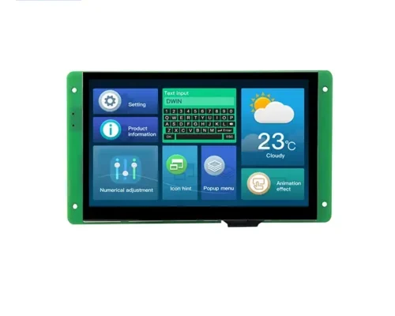
DWIN Display
DWIN DMG80480C070_04WTC – Key Specs
Display: 7.0" TFT LCD, 800×480 resolution
Touch: Capacitive touch panel
Colors: 262K
Viewing Angle: L/R 70°, U 40°, D 30°
System: DGUS II (T5L0 ASIC)
Memory: 16MB NOR Flash (fonts, images, audio)
Interface: 10-pin socket (power + serial)
Download: SD card / serial port
GUI Tools: DGUS V7.6 software (no coding)
Extras: Buzzer, IIC CTP interface, RGB LCM interface

Slide 9
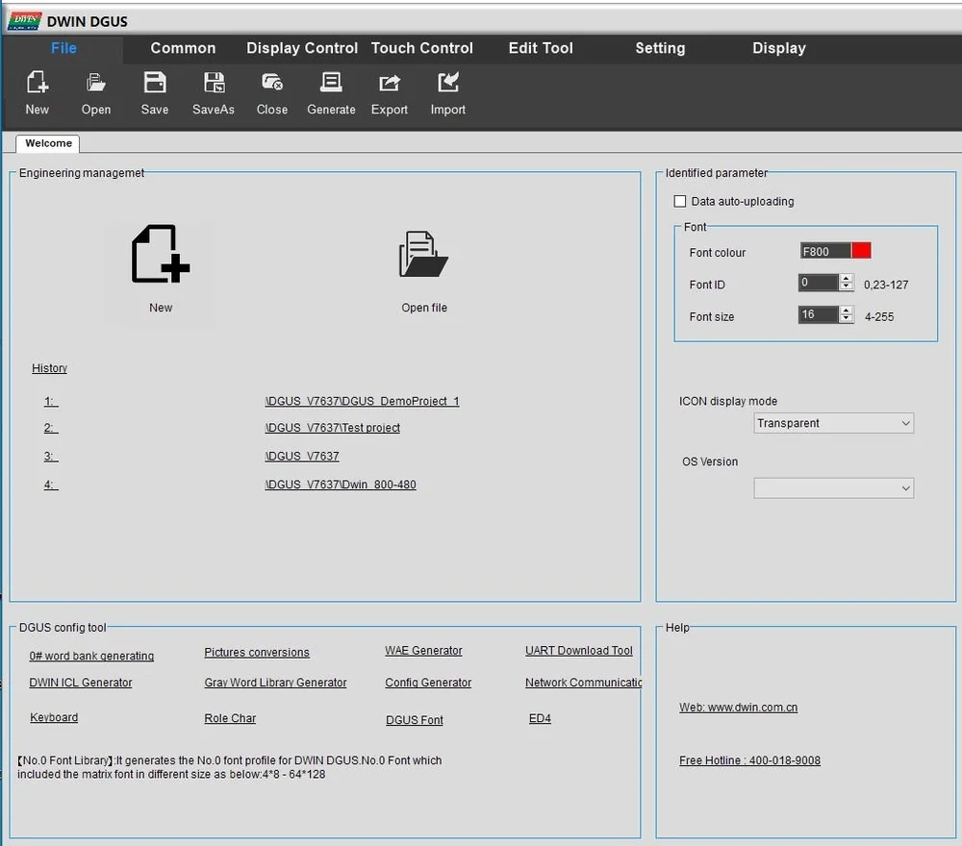
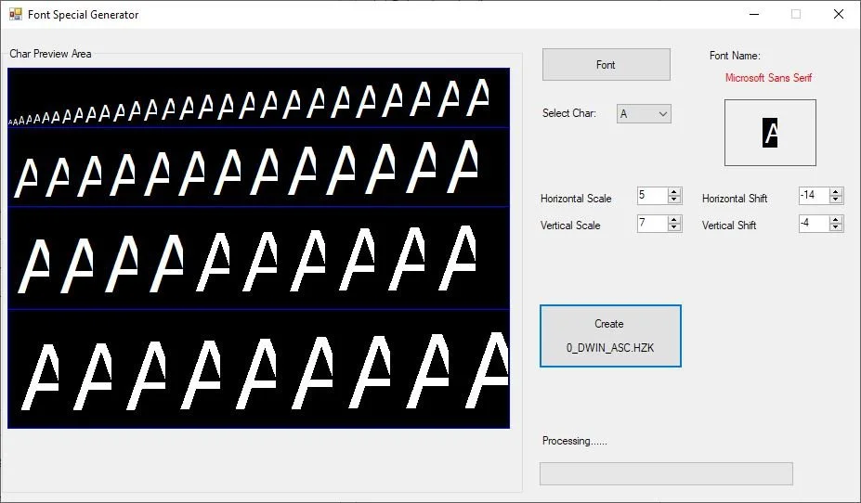
DGUS Software
📂 New Project → Start fresh or open existing
🖥️ Resolution → Enter 480X800 (capital “X” required)
⚠️ Tip → Lowercase “x” causes error
⚙️ Touch & Display Config → Appears after project creation
🔤 Generate Fonts → Do this before configuring display

Slide 10
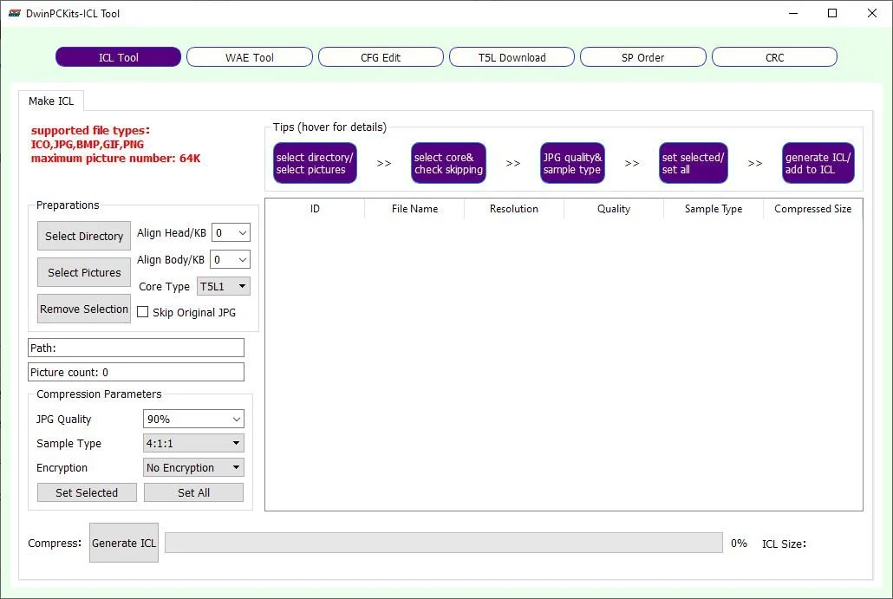
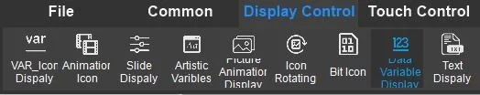
Configuration Setup
DGUS Display – Background Setup & Serial Demo
Background image setup
Name file as 00_background.jpg
Load into DWIN ICL Generator
Generate ICL file named 32.ICL
Naming rules
Prefixes (00, 32) help display identify file types
Incorrect names may cause issues
Editor setup
Add elements: buttons, sliders, icons, curves, etc.
Demo goal
Send data from serial port to display
Trigger serial messages via touch interaction

Slide 11
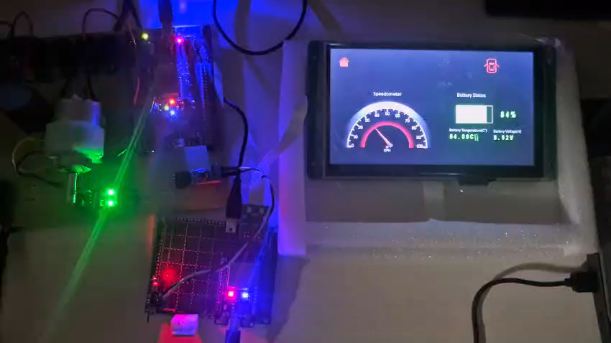

Slide 12
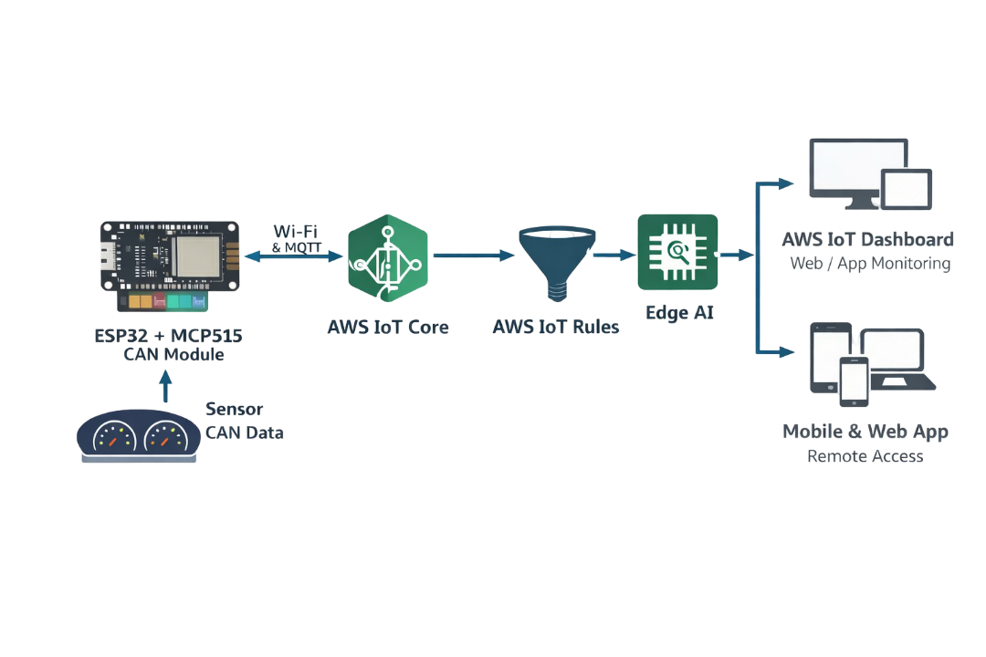
IOT and Edge AI
Present To Future

Slide 13
Application & Future Scope
Applications
Real-time vehicle dashboard monitoring
Electric and smart vehicle systems
Cloud-based vehicle monitoring
Automotive testing and research
Remote monitoring via web and mobile apps
Future Scope
Fleet tracking and vehicle diagnostics
Direct peripheral control via dashboard
Enhanced vehicle security integration
Infotainment-enabled smart dashboard

Slide 14
Conclusion
The smart car dashboard system successfully enables real-time monitoring of vehicle parameters.
CAN Communication ensures reliable and noise-immune data transfer between ECUs.
FreeRTOS-based architecture provides deterministic and efficient performance.
Integration with ESP32 and AWS IoT enables cloud-based remote monitoring and data access.
The System features a scalable and modular design, suitable for future expansion.
Overall, the solution improves vehicle safety, reliability, and user awareness, making it suitable for modern automotive application.

Slide 15
THANK YOU

